Slide 1
Lec - 8

Slide 2

Object beyond 2F₁
If the incident ray is parallel to the principal axis
The refracted ray passes through the focus F₂
A
2
2
2
2
B'
B
2F₁
F₁
O
F₂
2F₂
A'
Position of Image :
Between F₂ and 2F₂
A incident ray passes through the optical centre
passes without changing direction
Nature of Image :
Real
Inverted
(C) Smaller

Slide 3
Object at 2F₁
A
B'
B
2F₁
F₁
O
F₂
2F₂
A'
Position of Image :
At 2F₂
Nature of Image :
Real
Inverted
(C) Same size

Slide 4
Object between F₁ and 2F₁
A
B'
2F₁
B
F₁
O
F₂
2F₂
Position of Image :
Beyond 2F₂
A'
Nature of Image :
Real
Inverted
(C) Larger

Slide 5
Object at F₁
A
2F₁
B
F₁
O
F₂
2F₂
Position of Image :
At infinity
Nature of Image :
Real
Inverted
(C) Very large

Slide 6
Object between F₁ and O
A'
A
2F₁
B'
F₁
B
O
F₂
2F₂
Position of Image :
On the same side
Nature of Image :
Virtual
Erect
(C) Large

Slide 7


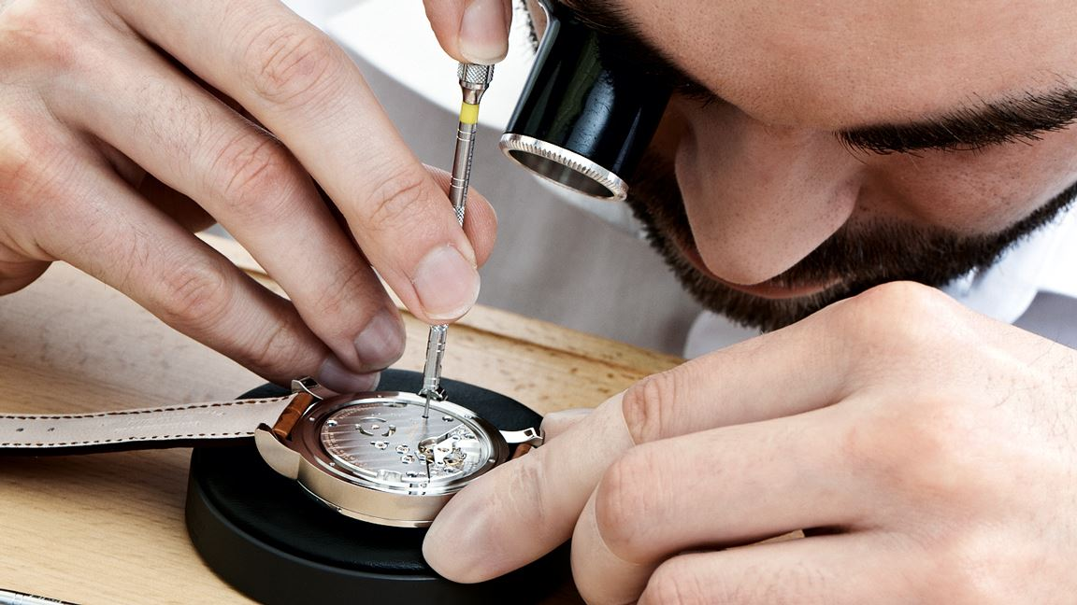
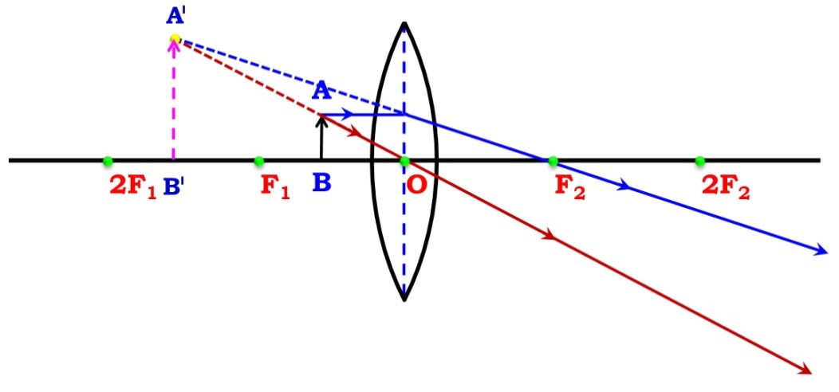
SIMPLE MICROSCOPE
When an object is placed within the focal length of a convex lens we get a virtual, erect and a large image on the same side.
One can get a 20 time larger image of an object using such microscopes.

Slide 8
Object at infinity
A
2F₁
F₁
O
F₂
2F₂
B
Position of Image :
At focus
Nature of Image :
Real
Inverted
(C) Point image

Slide 9


Where should an object be placed in front of a convex lens to get a real image of the size of the object?
(a) At the principal focus of the lens
(b) At twice the focal length
(c) At infinity
(d) Between the optical centre of the lens and its principal focus.
Q.
Ans.
(b) At twice the focal length

Slide 10
Q.
One half of a convex lens is covered with a black paper. Will this lens produce a complete image of the object? Justify your answer.
Ans.
Lens will produce a complete image of the object.
Intensity of the image is reduced because rays from the top portion of the lens only are refracted and forms the image.

Slide 11
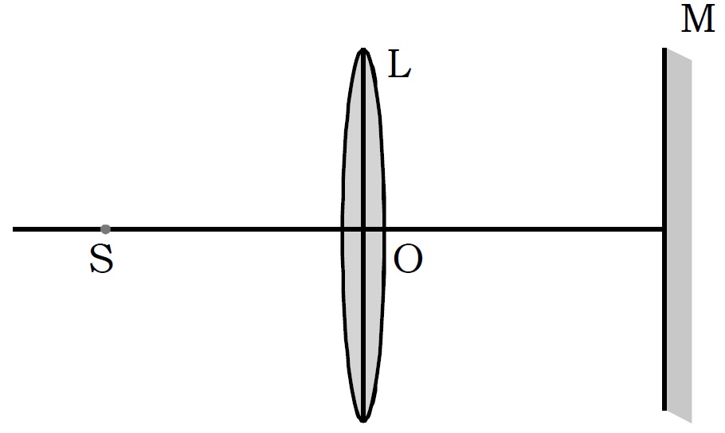
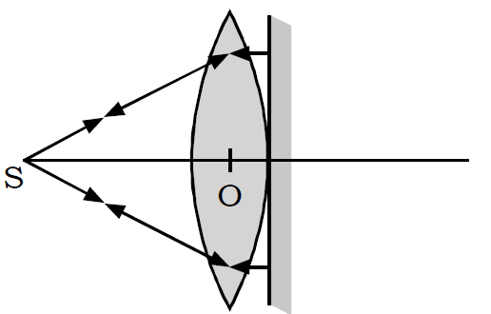
Figure below shows a point source of light S, a convex lens L and a plane mirror M. The three are placed such that rays of light from S return to it after reflection from M.
(i) What is the distance OS called (ii) To which point (left of S, on S or right of S) will the rays returns if M is moved to the left and brought in contact with L ?
Q.
Ans.
(i) The distance OS is called the focal length of the lens.
(ii) The rays will still return to the same point S. The ray diagram of the situation is as shown below:

Slide 12
A student set up the apparatus for determining the focal length of a
convex lens as shown below. She told her friend that the approximate focal length of lens was 10 cm. She asked him to place the screen, so that the image of a distant object is obtained on it by slight adjustment. He placed the screen at a mark of
(a) 10 cm (b) 40 cm (c) 50 cm (d) 45 cm
Q.
Ans.
= 30cm + f
L
= 40 cm
0
10
20
30
40
50
60

Slide 13
Thank You

